Slide 1
Functional Dependencies and Normalization for Relational Databases

Slide 2
Functional Dependencies
Functional dependencies (FDs) are used to specify formal measures of the "goodness" of relational designs
FDs and keys are used to define normal forms for relations
FDs are constraints that are derived from the meaning and interrelationships of the data attributes

Slide 3
Functional Dependencies (2)
A set of attributes X functionally determines a set of attributes Y if the value of X determines a unique value for Y
X →Y holds if whenever two tuples have the same value for X, they must have the same value for Y
  If t1[X]=t2[X], then t1[Y]=t2[Y] in any relation instance r(R)
X → Y in R specifies a constraint on all relation instances r(R)
FDs are derived from the real-world constraints on the attributes

Slide 4
Examples of FD constraints
Social Security Number determines employee name
  SSN → ENAME
Project Number determines project name and location
  PNUMBER → {PNAME, PLOCATION}
Employee SSN and project number determines the hours per week that the employee works on the project
  {SSN, PNUMBER} → HOURS

Slide 5
Functional Dependencies (3)
An FD is a property of the attributes in the schema R
The constraint must hold on every relation instance r(R)
If K is a key of R, then K functionally determines all attributes in R (since we never have two distinct tuples with t1[K]=t2[K])

Slide 6
Inference Rules for FDs : Armstrong’s axioms
Given a set of FDs F, we can infer additional FDs that hold whenever the FDs in F hold
Armstrong's inference rules
  A1. (Reflexive) If Y subset-of X, then X → Y
  A2. (Augmentation) If X → Y, then XZ → YZ
  (Notation: XZ stands for X U Z)
  A3. (Transitive) If X → Y and Y → Z, then X → Z
A1, A2, A3 form a sound and complete set of inference rules

Slide 7
Additional Useful Inference Rules
Self-determination: X→ X
Decomposition
  If X → YZ, then X → Y and X → Z
Union
  If X → Y and X → Z, then X → YZ
Psuedotransitivity
  If X → Y and WY → Z, then WX → Z
Closure of a set F of FDs is the set F+ of all FDs that can be inferred from F

Slide 8
Closure set of FD
A closure of a set of FDs is a set of all possible FDs that can be derived from a given set of FDs.
It is also referred as a complete set of FDs.
If F is set of FDs for relation R, then a closure a set of FDs is denoted by F⁺.
LHS and RHS of FDs are subsets of R : since set of size n has 2^{n} subsets, total 2^{n} X 2^{n} = 2^{2n} possible FDs.

Slide 9
Example : R = (A, B, C, G, H, I)
F = { A → B
A → C
CG → H
CG → I
B → H}
some members of F⁺
  A → H
    by transitivity from A → B and B → H
  AG → I
    by augmenting A → C with G, to get AG → CG
    and then transitivity with CG → I
  CG → HI
    Since CG → H and CG → I implies CG →HI
  Others : A → BC, AG → H,

Slide 10
Procedure for Computing F⁺
To compute the closure of a set of functional dependencies F:
F ⁺ = F
repeat
for each functional dependency f in F⁺
apply reflexivity and augmentation rules on f
add the resulting functional dependencies to F ⁺
for each pair of functional dependencies f₁and f₂ in F ⁺
if f₁ and f₂ can be combined using transitivity
then add the resulting functional dependency to F ⁺
until F ⁺ does not change any further

Slide 11
Algorithm : Attribute Closure set
Algorithm to compute a⁺, the closure of a under F
result:= a;
while (changes to result) do
for each β→γ in F do
Begin
if β ⊆ result then result := result ∪ γ
end
OTHER Uses :
To test given attribute(s) is superkey/candidate key or not.
We can check if FD X→Y holds or not.
An alternative way to find out F⁺

Slide 12
Example : Let R = (A, B, C, G, H, I) and set of FD are
F = { A → B, A → C, CG → H, CG → I, B → H}
Find out (AG)⁺
Result = {A,G}
First loop:
  A → B includes B in result.
  as A⊆ result (which is AG), so result := result ∪B.
  A→C causes result to become ABCG.
  CG→H causes result to become ABCGH.
  CG→I causes result to become ABCGHI.
result has been changed so repeat same steps again
At the end of second loop Result does not change so exit from loop.
(AG)+ = {A,B,C,G,H,I}
( AG is also a super key as all other attributes can be determined by it.)

Slide 13
Example : Let R = (A, B, C, G, H, I) and set of FD are
F = { A → B, A → C, CG → H, CG → I, B → H}
Check HB→I holds or not
Result = {H,B}
First loop:
  A → B
  as A ⊆ result (which is HB) so nothing will be added .
  A→C nothing added
  CG→H (CG ⊆ result (which is HB) so nothing added )
  CG→I nothing added
  B→H nothing added
At the end of first loop Result does not change so exit from loop.
HB → I does not hold .

Slide 14
Example
Given a Relation R (A,B,C,D,E,F) and set of FDs
F: {A→BC, E→CF, B→E, CD→EF}
Find out closure of {A,B}⁺

Slide 15
Step-1: result=AB
Step-2: First loop
      result=ABC
      result=ABC
      result=ABCE
      result=ABCE
# for A → BC, A ⊆result so result=result ∪ BC
# for E→ CF, E∉result so result=result
# for B→E, B⊆result so result=result ∪E
# for CD→EF, CD∉result so result=result
result before step2 is AB and after step 2 is ABCE which is different so repeat same as step 2.
Step-3:Second loop
  result=ABCE
  result=ABCEF
  result=ABCEF
  result=ABCEF
# for A → BC, A ⊆ result so result=result ∪ BC
# for E→ CF, E ⊆ result so result=result ∪ CF
# for B→E, B ⊆ result so result=result ∪ E
# for CD→EF, CD ∉result so result=result

Slide 16
result before step3 is ABCE and after step 3 is ABCEF which is different so repeat same as step 3.
Step-4: Third loop
result=ABCEF
result=ABCEF
result=ABCEF
result=ABCEF
# for A → BC, A ⊆ result so result=result ∪ BC
# for E→ CF, E ⊆ result so result=result ∪ CF
# for B→E, B ⊆ result so result=result ∪ E
# for CD→EF, CD ∉result so result=result
result before step4 is ABCEF and after step 3 is ABCEF which is same so stop.
So Closure of {A,B}⁺ is {A, B, C, E, F}.

Slide 17
Example : Compute the closure of R(A, B, C, D, E) with the following set of functional dependencies and list the candidate keys of R.
A → BC CD → E B →D E→A
Solution : Find the closure sets : A⁺, CD⁺, B⁺, E⁺
A⁺ = {A,B,C,D,E}
CD⁺ ={A,B,C,D,E}
B⁺ ={B,D}
E⁺ = {A,B,C,D,E}
A, CD, E are
candidate keys
Closure sets
A -> ABCDE
B -> BD
C -> C
D -> D
E -> ABCDE
AB -> ABCDE
AC -> ABCDE
AD -> ABCDE
AE -> ABCDE
BC -> ABCDE
BD -> BD
BE -> ABCDE
CD -> ABCDE
CE -> ABCDE
DE -> ABCDE
ABC -> ABCDE
ABD -> ABCDE
ABE -> ABCDE
ACD -> ABCDE
ACE -> ABCDE
ADE -> ABCDE
BCD -> ABCDE
BDE -> ABCDE
CDE -> ABCDE
ABCD -> ABCDE
ABCE -> ABCDE
ABDE -> ABCDE
ACDE -> ABCDE
BCDE -> ABCDE

Slide 18
Example
Consider the following relation schema Depositer_Account (cid, ano, acess_date, balance, bname).
F = { {cid, ano } →access_date ,
ano→ { balance, bname } }
Find out {cid, ano } ⁺
Find out { ano }⁺

Slide 19
Find out { cid, ano }⁺
Result = {cid, ano }
ano→ { balance, bname }
ano ⊆ result (which is {cid, ano} )
so result := {cid,aco,balance, bname}
{cid, ano } →access_date
{cid,ano} ⊆ result (which is {cid,aco,balance, bname} )
so result := {cid,aco,balance, bname,access_date} = { cid, ano }⁺
Find out ano⁺
Result = {ano }
ano→ { balance, bname }
ano⊆ result (which is {ano} )
so result := {aco,balance, bname}
{cid, ano } →access_date
{cid,ano} ⊆ result (which is {aco,balance, bname} ) nothing added . so result := {aco,balance, bname} = {ano }⁺

Slide 20
Canonical cover or Irreducible set
Sets of functional dependencies may have redundant dependencies that can be inferred from the others
  For example:
  A → C is redundant in: {A → B, B → C, A→ C}
Intuitively, a canonical cover of F is a “minimal” set of functional dependencies equivalent to F, having no redundant dependencies or redundant parts of dependencies

Slide 21
Canonical cover or Irreducible set
A canonical cover for F is a set of dependencies F_{c} such that
  F logically implies all dependencies in F_{c}, and
  F_{c} logically implies all dependencies in F, and
  No functional dependency in F_{c} contains an extraneous attribute, and
  Each left side of functional dependency in F_{c} is unique.
Extraneous Attribute :
An attribute is said to be extraneous if we can remove it without changing the closure of the set of functional dependencies.

Slide 22
Formal Definition :
Consider a set F of functional dependencies and the functional dependency α → β in F.
  Attribute A is extraneous in α if A ∈ α
  and F logically implies (F – {α → β}) ∪ {(α – A) → β}.
  Attribute A is extraneous in β if A ∈ β
  and the set of functional dependencies
  (F – {α → β}) ∪ {α →(β – A)} logically implies F.
Example: Given F = {A → C, AB → C }
  B is extraneous in AB → C because {A → C, AB → C} logically implies A → C
Example: Given F = {A → C, AB → CD}
  C is extraneous in AB → CD since AB → C can be inferred even after deleting C

Slide 23
Testing if an Attribute is Extraneous
Consider a set F of functional dependencies and the functional dependency α → β in F.
To test if attribute A ∈ α is extraneous in α
  compute ({α} – A)⁺ using the dependencies in F
  check that ({α} – A)⁺ contains β; if it does, A is extraneous in α
To test if attribute A ∈ β is extraneous in β
  compute α⁺ using only the dependencies in
  F’ = (F – {α → β}) ∪ {α →(β – A)},
  check that α⁺ contains A; if it does, A is extraneous in β

Slide 24
Algorithm
To compute a canonical cover for F:
repeat
Use the union rule to replace any dependencies in F
α₁ → β₁ and α₁ → β₂ with α₁ → β₁ β₂
Find a functional dependency α → β with an
extraneous attribute either in α or in β
/* Note: test for extraneous attributes done using F_{c,} not F*/
If an extraneous attribute is found, delete it from α → β
until F does not change

Slide 25
Find out canonical cover for following
R = (A, B, C)
F = {A → BC, B → C, A → B, AB → C}
Solution:
Combine A → BC and A → B into A → BC
  Set is now {A → BC, B → C, AB → C}
A is extraneous in AB → C
  Check if the result of deleting A from AB → C is implied by the other dependencies
    Yes: in fact, B → C is already present!
  Set is now {A → BC, B → C}
C is extraneous in A → BC
  Check if A → C is logically implied by A → B and the other dependencies
    Yes: using transitivity on A → B and B → C.
      Can use attribute closure of A in more complex cases
The canonical cover is: A → B, B → C

Slide 26
Types of functional dependencies
Transitive Dependency
  In a relation, if attribute(s) A→B and B→C, then C is transitively dependent on A via B (provided that A is not functionally dependent on B or C).
Trivial FD:
  X→Y is trivial FDif Y is a subset of X
  Eg.{Roll_No, Department_Name}→Roll_No
Nontrivial FD
  X→Y is nontrivial FDif Y is not a subset of X
  Eg.. {Roll_No, Department_Name}→Student_Name

Slide 27
Decomposition
The process of breaking down given relation into two or more relations in such a way that:
  Each new relation contains a subset of the attributes of R, and
  Together, they all include all tuples and attribites of R.
Using functional dependencies, R relation is decomposed into a set of relation schemas D = {R1, R2, R3,…,Rn}.
Generally, decomposition is used to eliminate the pitfalls of the poor database design during normalization process.

Slide 28
Types of decomposition
Lossy decomposition
The decomposition of relation R into R1 and R2 is lossy when the join of R1 and R2 does not yield the same relation as in R.
The disadvantage : some information is lost during retrieval of original relation.
From practical point of view, decomposition should not be lossy decomposition.

Slide 29
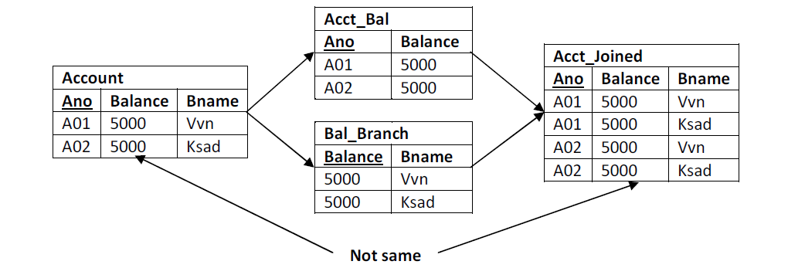
Example : lossy

Slide 30
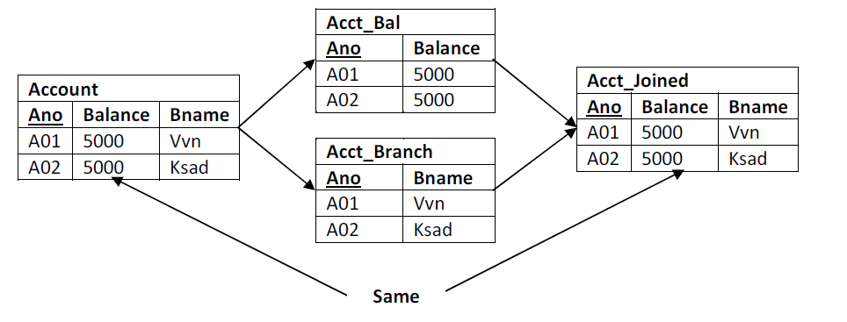
Lossless decomposition:
  The decomposition of relation R into R1 and R2 is lossless when the join of R1 and R2 produces the same relation as in R.

